Slide 1
EDA of health and population growth: Arab world / Latin America & Caribbean

Slide 2
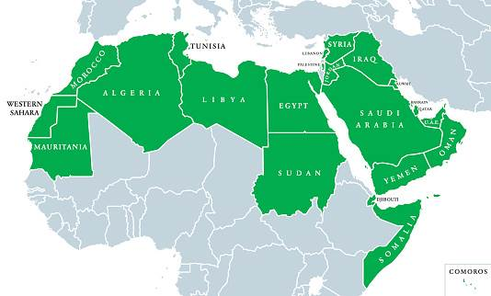
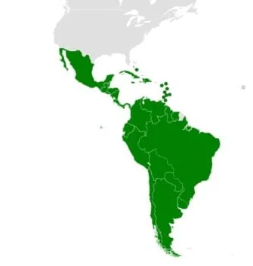
AGENDA
Introduction
EDA Background Info
Urban vs. Rural: Birth / Death Rates
Urban vs. Rural: Percentage of Population Growth
Urban vs. Rural: Fertility and Birth Rates
Survival Rates: Beyond Age 65
Closing Comments / Post Analysis
Acronym List:
Arab World = ARB
Latin America & Caribbean = LCN

Slide 3
EDA Background information
Scope of EDA Dataset
Key Topics of Presentation
Technique of Information Cleaning
Notes:
Good afternoon! I’m Phil Meeks, introducing for the Data Analytics Immersive Cohort number 10.In our presentation this afternoon, we’re discussing our team’s exploratory data analysis (EDA) of Health Nutrition and Population Statistics Compiled by the World Bank from 1960 to 2014.The scope will include an analysis of two areas: the Arab World and Latin America & Caribbean. Key topics: - Comparing birth and death rates in urban and rural areas. - Comparing urban and rural population as a percentage of total population. - Comparing fertility and birth rates in urban and rural areas. - Comparing survival rates for males and females. First, how did conduct the analysis? - sourced a .csv from the World Bank - we saw more than 50,000 entries covering locations around the world with over 340 unique factors affecting population - after exploring those data points, our team decided to limit our EDA to population analysis for the Arab World and Latin American & Caribbean - this analysis built a model for future analysis on other areas provided in the source data - from there, we filtered for our factors using the indicator codes provided by the world bank for birth and death rates, fertility rates, population broken down by urban and rural areas, and finally, survival rates to age 65 by male and female.I’ll be followed by Brayden who will cover our analysis of urban and rural population change.

Slide 4
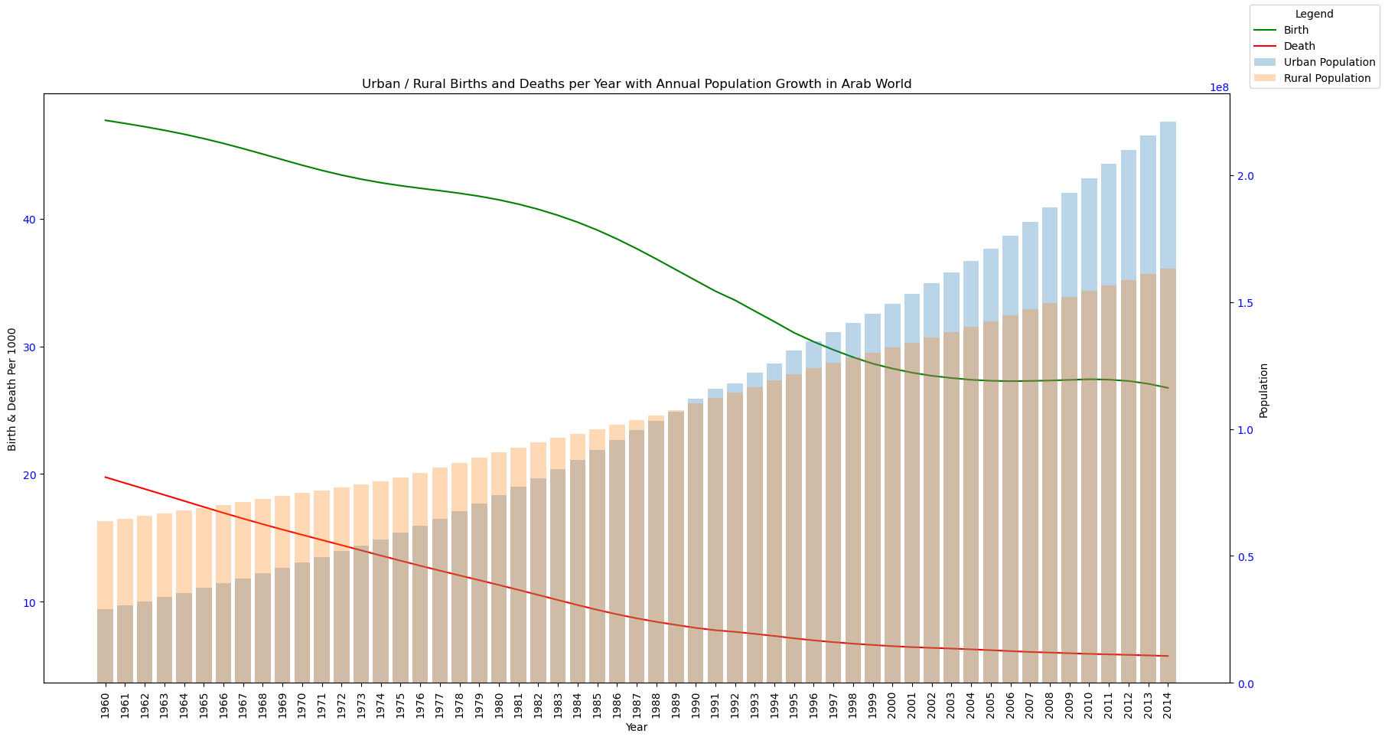
Urban vs. Rural: Birth / Death Rates for ARB
Notes:
Brayden: X and Y Labels. Data Set with Hist and Line Plot

Slide 5
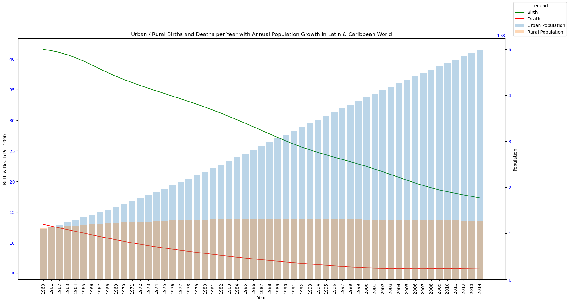
Urban vs. Rural: Birth / Death Rates for LCN
Notes:
Brayden: X and Y Labels. Data Set with Hist and Line Plot

Slide 6
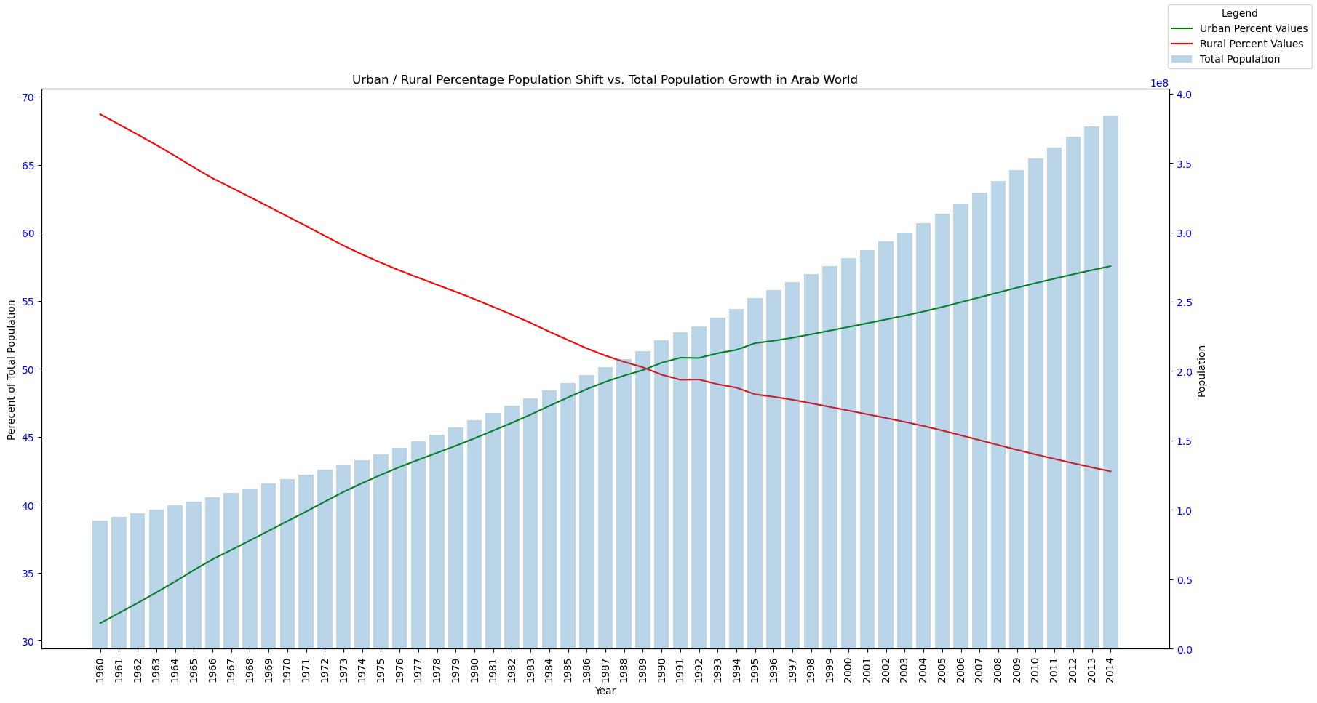
Urban vs. Rural: Total pop growth arb

Slide 7
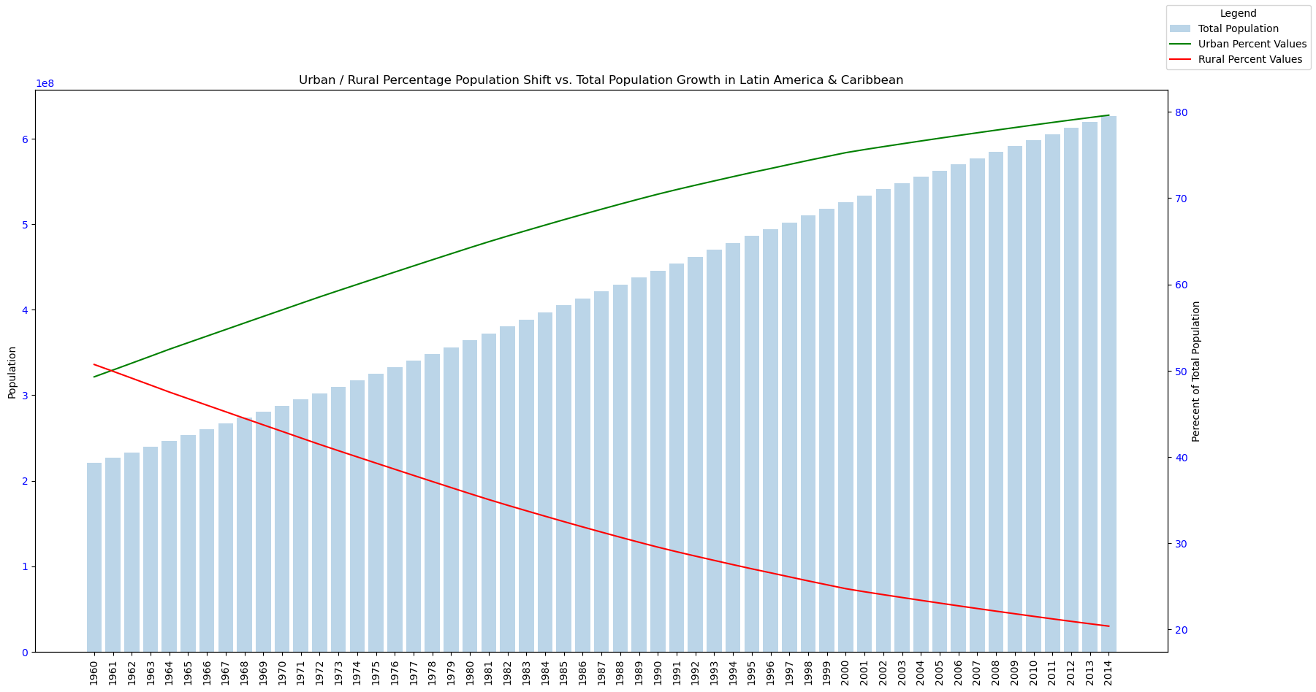
Urban vs. Rural: Total pop growth lcn

Slide 8
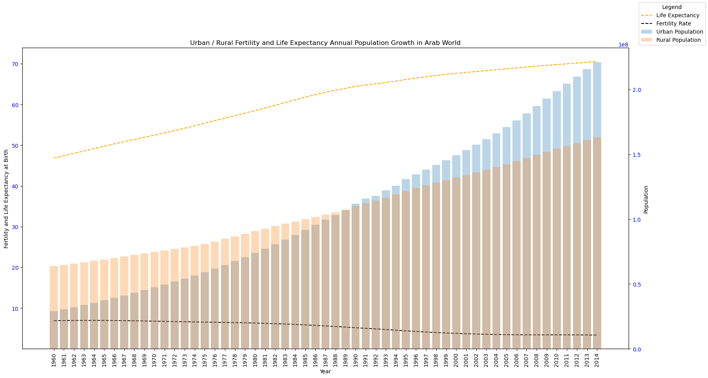
Urban & Rural: life expectancy & fertility rates for arb

Slide 9
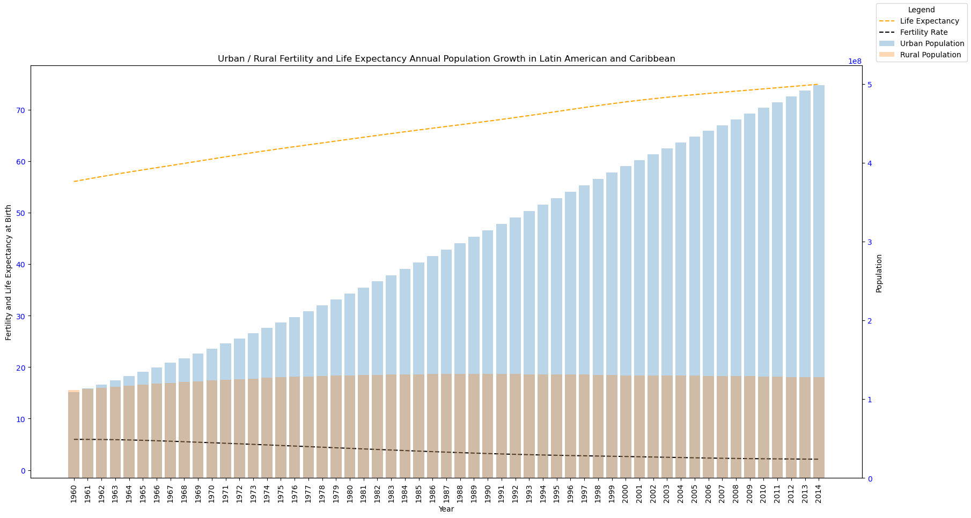
Urban & Rural: life expectancy & fertility rates for lcn

Slide 10
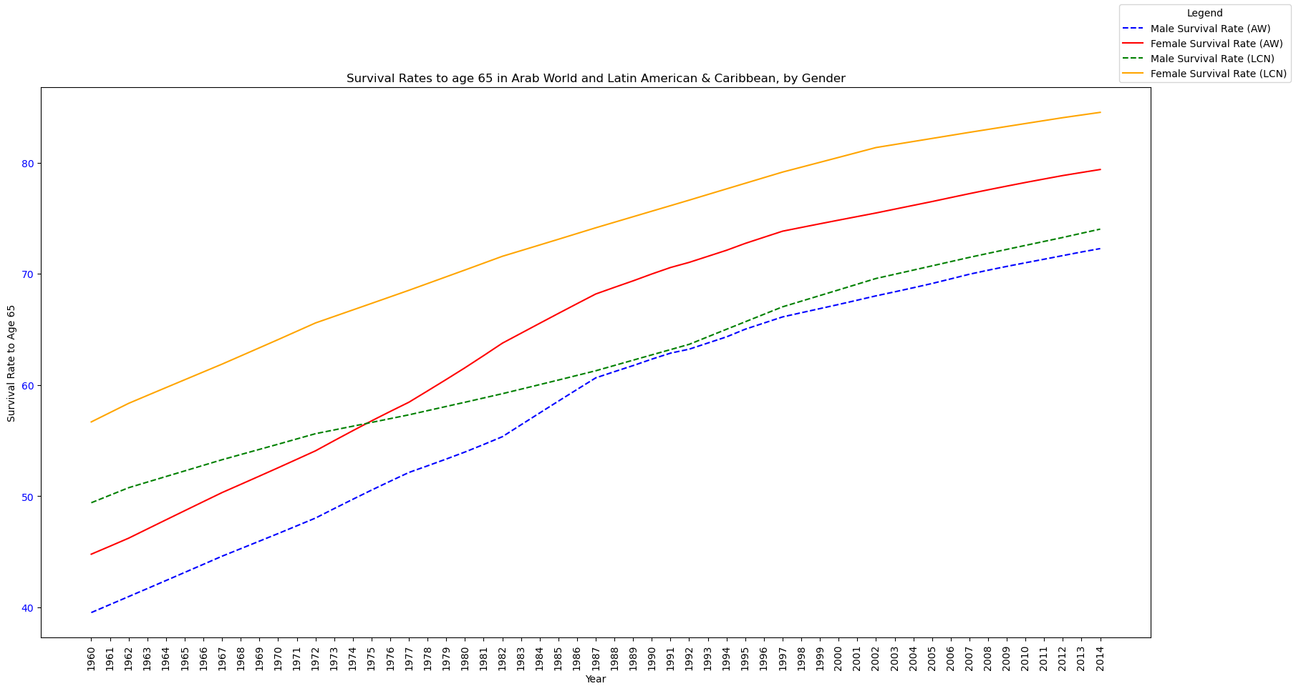
Survival rates to age 65 for arb and lcn by gender

Slide 11
Questions? Comments?

